Slide 1
VOICE ASSISTANT

Slide 2
TABLE OF CONTENT
WHAT IS VOICE ASSISTANT
Caption
needs.
USES
MY TECH BUDDY
Cap
This slide is an editable slide with all your needs.
WORKING
CONCLUSION
Caption
This slide is an editable slide with all your needs.

Slide 3


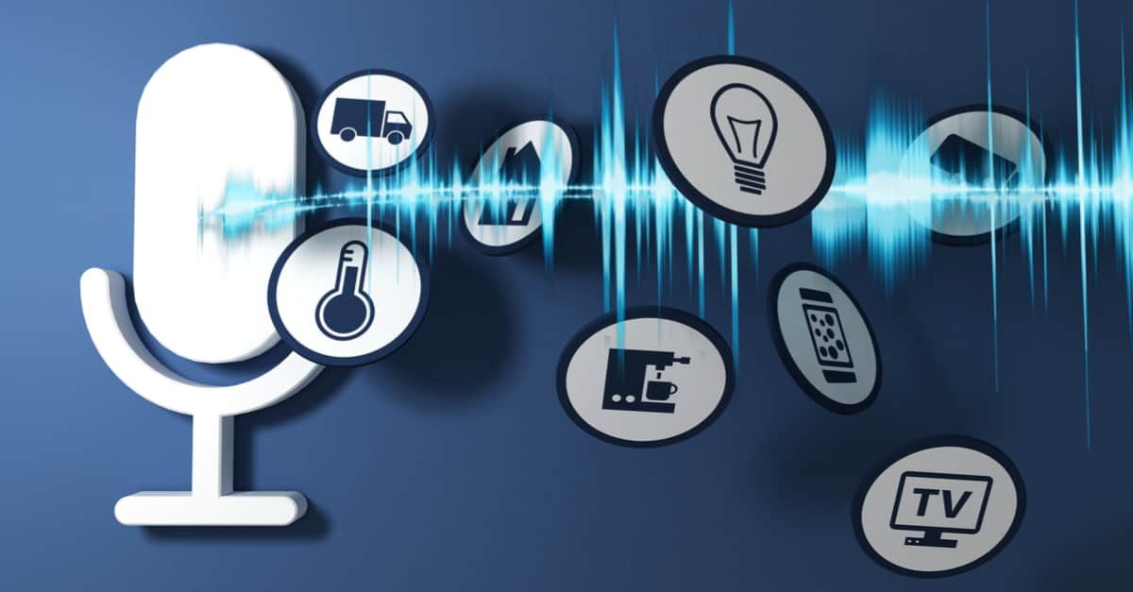
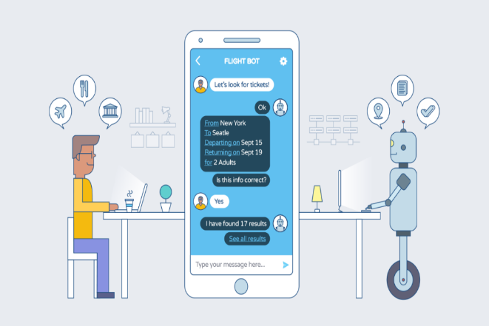
WHAT IS VOICE ASSISTANT?
A voice assistant is a digital assistant that uses voice recognition, language processing algorithms, and voice synthesis to listen to specific voice commands and return relevant information or perform specific functions as requested by the user.

Slide 4
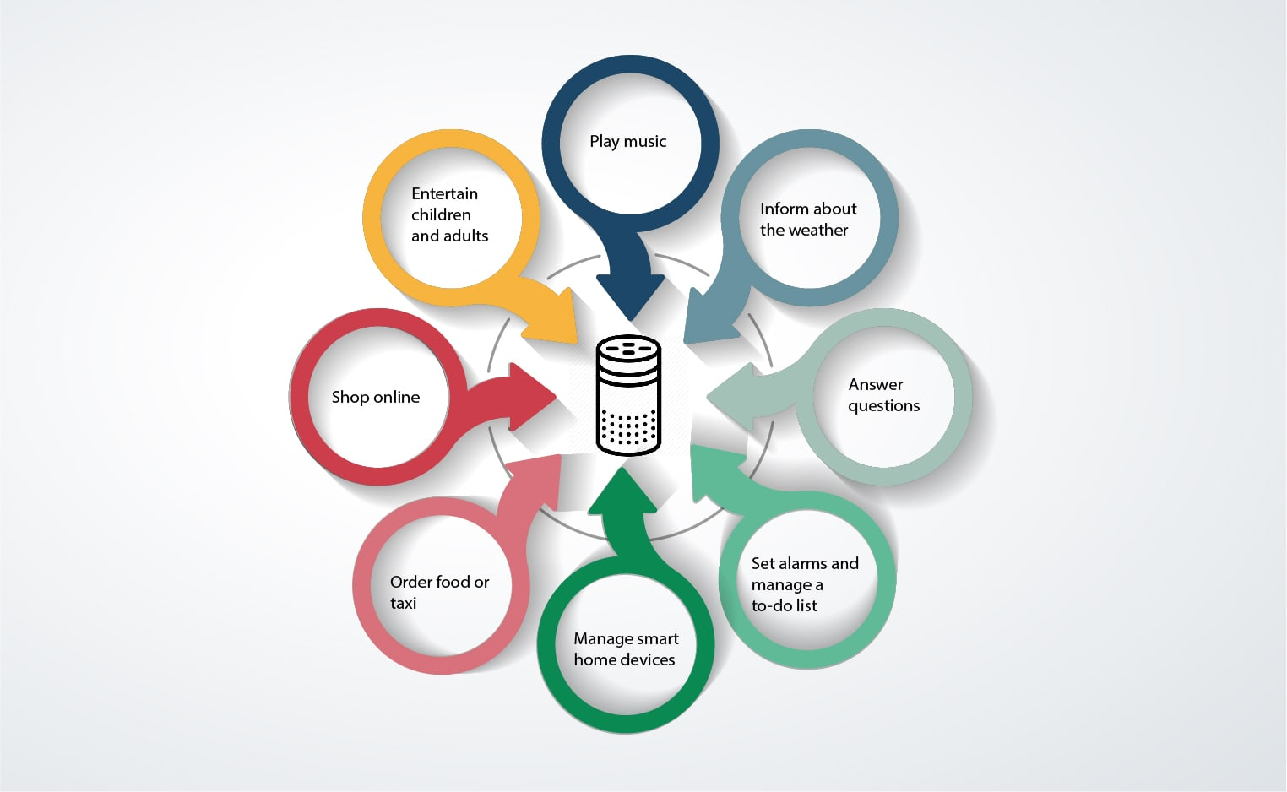
USES OF VOICE ASSISTANT

Slide 5
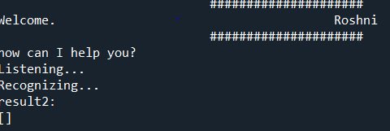
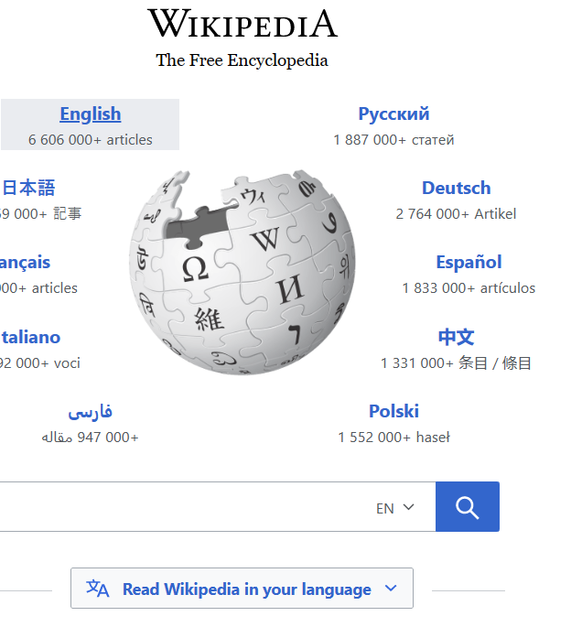
Some snaps
welcome
Asking to open wikipedia
output

Slide 6
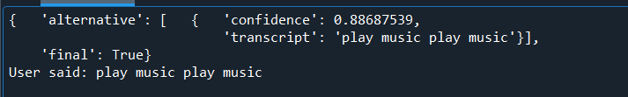
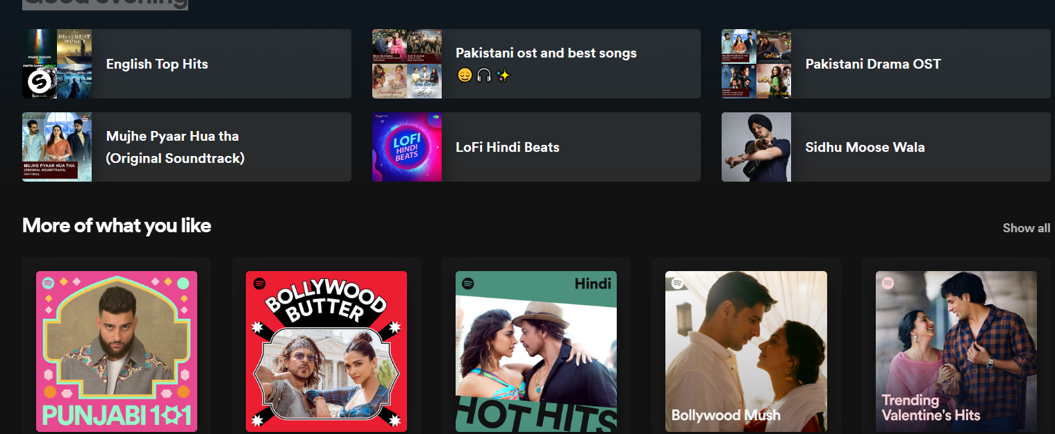

SNAPS
Asked to play music
Audio clip
output

Slide 7
Basic termalogies
python
pip
subprocess
pytts
json
Speech recognition
winshell
feedparser
twilio
smtplib

Slide 8
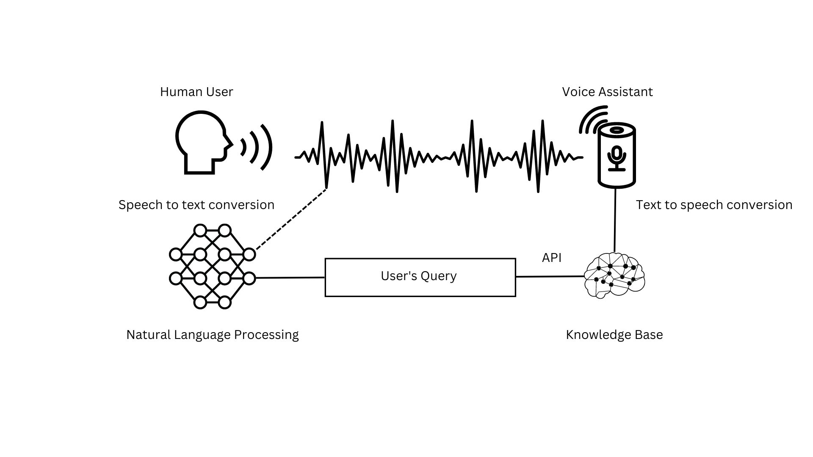
WORKING

Slide 9
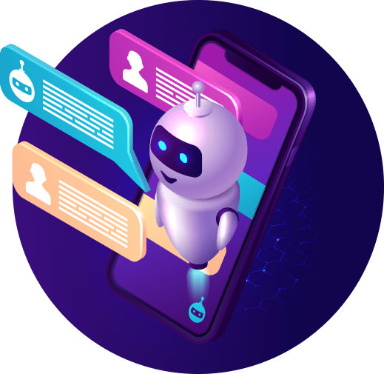
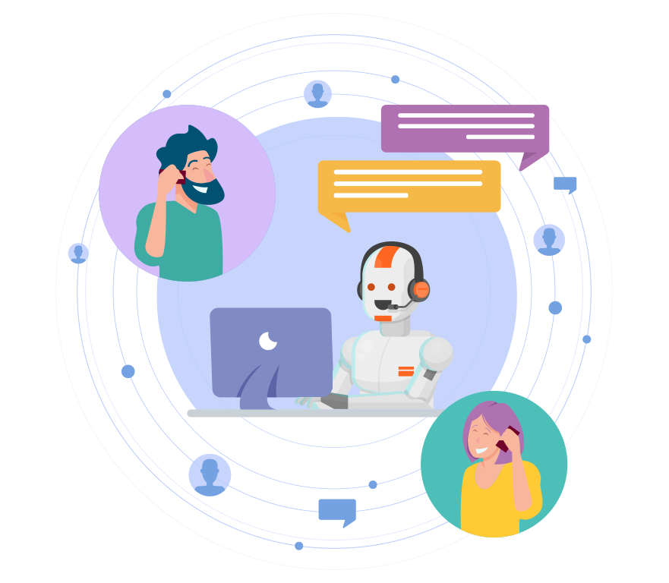
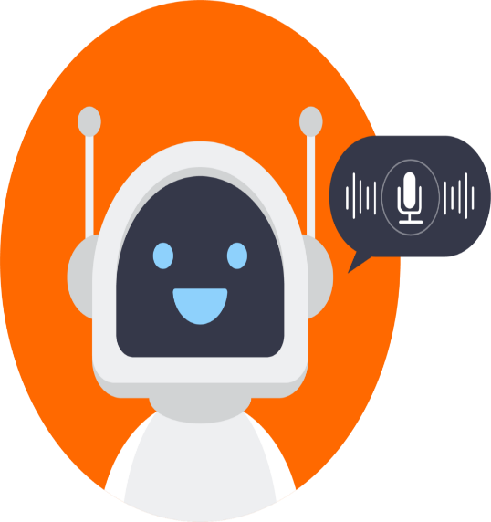
conclusion
In conclusion, it seems that voice assistant are well on their way to continuing their development in our daily lives. Their promising functionalities make our everyday life easier, and these conversational agents offer greater fluidity, speed and time savings to the users

Slide 10
